Slide 1
Hospital Readmissions is a problem
$41B spent annually treating patients within 30 days of their initial discharge
Government programs Medicare/Medicaid fine hospitals for readmissions driving up costs
Additional patient hardship, stress & strain

Slide 2


Supervised Learning
Inferring a function from labeled data.
“Learn from telling”, “Look at my data and I will tell you what to predict”
Data Setup
Method
Business Examples
Application
Marketing-Will a customer buy yes or no? How much will a customer spend?
Operations- Will an applicant default? When will a machine break?
Flat “Excel” file. Each row is a record or observation. Each column is an attribute of the record.
One column is the outcome, y or target attribute.
Modeling e.g. K-NN, linear regression, decision tree, random forest etc.
Make predictions for the target on the new data.

Slide 3
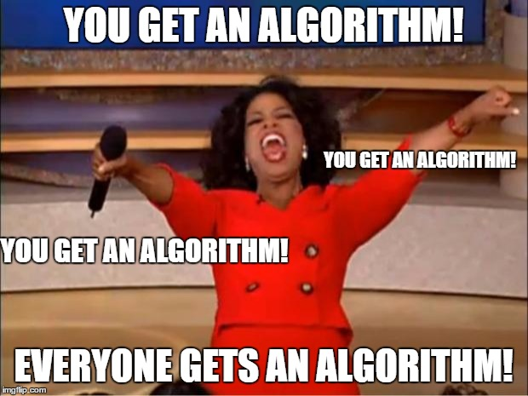
What is a model? What are we trying to do?
An model is a set of rules governing actions or phenomena.
Empirical Support without math
Your brain:
Algo#1: “fur” =Y, “tail”=Y, “claws”=Y, “meow”=Y therefore high probability that’s a cat
Algo#2: “another meme”=Y, “short & bald professor”=Y therefore “professor trying too hard to be cool”
Algorithms or mental models of reality can be correct or lead you to incorrect assumptions.

Slide 4
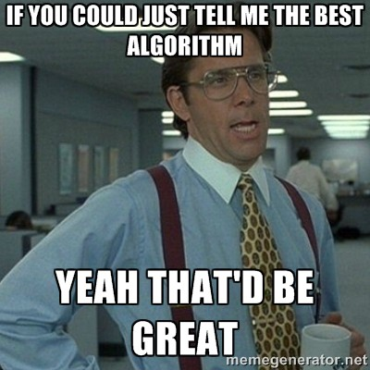
What is a model?
A model is a set of rules predicting actions or phenomena.
Empirical Support w/math
The way you instruct the rules to be constructed is the algorithm (KNN, RF, LogReg etc)
Computers can learn complex representations of phenomena
Just like mental algorithms, the observations we give a mathematical algorithm which result in a final model (set of rules) can lead to correct or incorrect assumptions. “Garbage in…Garbage out.”

Slide 5
Data Structure for Analysis & Modeling
Often the 1st Column is a unique identifier but the identifier could also be a row attribute (not actually a vector)
name | mfr | type | calories | protein | fat | sodium | fiber | carbo | sugars | potass | vitamins | shelf | weight | cups | rating
100%_Bran | N | C | 70 | 4 | 1 | 130 | 10 | 5 | 6 | 280 | 25 | 3 | 1 | 0.33 | 68.40297
100%_Natural_Bran | Q | C | 120 | 3 | 5 | 15 | 2 | 8 | 8 | 135 | 0 | 3 | 1 | 1 | 33.98368
All-Bran | K | C | 70 | 4 | 1 | 260 | 9 | 7 | 5 | 320 | 25 | 3 | 1 | 0.33 | 59.42551
All-Bran_with_Extra_Fiber | K | C | 50 | 4 | 0 | 140 | 14 | 8 | 0 | 330 | 25 | 3 | 1 | 0.5 | 93.70491
Almond_Delight | R | C | 110 | 2 | 2 | 200 | 1 | 14 | 8 |  | 25 | 3 | 1 | 0.75 | 34.38484
Apple_Cinnamon_Cheerios | G | C | 110 | 2 | 2 | 180 | 1.5 | 10.5 | 10 | 70 | 25 | 1 | 1 | 0.75 | 29.50954
Apple_Jacks | K | C | 110 | 2 | 0 | 125 | 1 | 11 | 14 | 30 | 25 | 2 | 1 | 1 | 33.17409
Basic_4 | G | C | 130 | 3 | 2 | 210 | 2 | 18 | 8 | 100 | 25 | 3 | 1.33 | 0.75 | 37.03856
Bran_Chex | R | C | 90 | 2 | 1 | 200 | 4 | 15 | 6 | 125 | 25 | 1 | 1 | 0.67 | 49.12025
Bran_Flakes | P | C | 90 | 3 | 0 | 210 | 5 | 13 | 5 | 190 | 25 | 3 | 1 | 0.67 | 53.31381
Cap'n'Crunch | Q | C | 120 | 1 | 2 | 220 | 0 | 12 | 12 | 35 | 25 | 2 | 1 | 0.75 | 18.04285
Generally we will use data frames to avoid complexity but you will be exposed to other data types.

Slide 6
Data Structure for Analysis & Modeling
Informative features are usually independent & do not lend information to other rows (auto-correlation). Can be called informative columns, independent variables, or features.
Remember in a DF, these can be mixed with decimals, integers, factors, strings, T/F.
name | mfr | type | calories | protein | fat | sodium | fiber | carbo | sugars | potass | vitamins | shelf | weight | cups | rating
100%_Bran | N | C | 70 | 4 | 1 | 130 | 10 | 5 | 6 | 280 | 25 | 3 | 1 | 0.33 | 68.40297
100%_Natural_Bran | Q | C | 120 | 3 | 5 | 15 | 2 | 8 | 8 | 135 | 0 | 3 | 1 | 1 | 33.98368
All-Bran | K | C | 70 | 4 | 1 | 260 | 9 | 7 | 5 | 320 | 25 | 3 | 1 | 0.33 | 59.42551
All-Bran_with_Extra_Fiber | K | C | 50 | 4 | 0 | 140 | 14 | 8 | 0 | 330 | 25 | 3 | 1 | 0.5 | 93.70491
Almond_Delight | R | C | 110 | 2 | 2 | 200 | 1 | 14 | 8 |  | 25 | 3 | 1 | 0.75 | 34.38484
Apple_Cinnamon_Cheerios | G | C | 110 | 2 | 2 | 180 | 1.5 | 10.5 | 10 | 70 | 25 | 1 | 1 | 0.75 | 29.50954
Apple_Jacks | K | C | 110 | 2 | 0 | 125 | 1 | 11 | 14 | 30 | 25 | 2 | 1 | 1 | 33.17409
Basic_4 | G | C | 130 | 3 | 2 | 210 | 2 | 18 | 8 | 100 | 25 | 3 | 1.33 | 0.75 | 37.03856
Bran_Chex | R | C | 90 | 2 | 1 | 200 | 4 | 15 | 6 | 125 | 25 | 1 | 1 | 0.67 | 49.12025
Bran_Flakes | P | C | 90 | 3 | 0 | 210 | 5 | 13 | 5 | 190 | 25 | 3 | 1 | 0.67 | 53.31381
Cap'n'Crunch | Q | C | 120 | 1 | 2 | 220 | 0 | 12 | 12 | 35 | 25 | 2 | 1 | 0.75 | 18.04285
Generally we will use data frames to avoid complexity but you will be exposed to other data types.

Slide 7
Data Structure for Analysis & Modeling
If we are doing supervised learning, there is a dependent variable.
This is the outcome and is “dependent” on the informative columns. An analysis with this vector can be binary, classification, or predictive.
name | mfr | type | calories | protein | fat | sodium | fiber | carbo | sugars | potass | vitamins | shelf | weight | cups | rating
100%_Bran | N | C | 70 | 4 | 1 | 130 | 10 | 5 | 6 | 280 | 25 | 3 | 1 | 0.33 | 68.40297
100%_Natural_Bran | Q | C | 120 | 3 | 5 | 15 | 2 | 8 | 8 | 135 | 0 | 3 | 1 | 1 | 33.98368
All-Bran | K | C | 70 | 4 | 1 | 260 | 9 | 7 | 5 | 320 | 25 | 3 | 1 | 0.33 | 59.42551
All-Bran_with_Extra_Fiber | K | C | 50 | 4 | 0 | 140 | 14 | 8 | 0 | 330 | 25 | 3 | 1 | 0.5 | 93.70491
Almond_Delight | R | C | 110 | 2 | 2 | 200 | 1 | 14 | 8 |  | 25 | 3 | 1 | 0.75 | 34.38484
Apple_Cinnamon_Cheerios | G | C | 110 | 2 | 2 | 180 | 1.5 | 10.5 | 10 | 70 | 25 | 1 | 1 | 0.75 | 29.50954
Apple_Jacks | K | C | 110 | 2 | 0 | 125 | 1 | 11 | 14 | 30 | 25 | 2 | 1 | 1 | 33.17409
Basic_4 | G | C | 130 | 3 | 2 | 210 | 2 | 18 | 8 | 100 | 25 | 3 | 1.33 | 0.75 | 37.03856
Bran_Chex | R | C | 90 | 2 | 1 | 200 | 4 | 15 | 6 | 125 | 25 | 1 | 1 | 0.67 | 49.12025
Bran_Flakes | P | C | 90 | 3 | 0 | 210 | 5 | 13 | 5 | 190 | 25 | 3 | 1 | 0.67 | 53.31381
Cap'n'Crunch | Q | C | 120 | 1 | 2 | 220 | 0 | 12 | 12 | 35 | 25 | 2 | 1 | 0.75 | 18.04285
Generally we will use data frames to avoid complexity but you will be exposed to other data types.

Slide 8
Modeling Process
In this course…
1. Obtain
The data has been curated for you
2. Scrub
Depending on level more or less data cleaning is needed
3. Explore
Dimension Reduction, summary stats, & visualization can also include Feature Engineering & Feature Enrichment
4. Model
Day 2
5. Interpret
Day 2
Often data is sampled from a large database so you can more quickly explore, apply methods and prototype before reassessing on full data.

Slide 9
Scrub: PreProcessing
Many algorithms cannot accept the data directly.
Thus you must preprocess your data before training.
Common Pre-Processing
Categorical Variables
Common Pre-Processing
Numeric Variables
Dummy Variables
Binning Low Frequency Levels
Changing to Numeric for Ordinal
Deal with Missing Levels
Deal with Missing
Outlier Detection
Binning

Slide 10

Dummy Variables
Always “1 Less than the State of Nature”
2 States of Nature = 1 Light Switch or “dummy variable”
Dog or Cat needs one column where dog =1, cat=0
If the column has a 0 then its a cat.
AI Generated: Stable Diffusion Picture
Represent non-numeric information as light switches.
Kwartler

Slide 11

Dummy Variables
Always “1 Less than the State of Nature”
3 States of Nature = 2 Light Switches or “dummy variables”
If both columns are 0 then by default, this is the same information as the row having a fish.
Dog | Cat
1 | 0
0 | 1
0 | 0
AI Generated: Stable Diffusion Picture
Represent non-numeric information as light switches.
Kwartler

Slide 12

Dummy Variables
Dummy Variables represent category levels as 1/0 within new vectors. For some approaches, this lets the algorithm understand the information.
Consider this data:
CuID | Gender | Profession | Affiliation
CU43E439 | Male | Nurse | Democrat
CU36E506 | Male | Teacher | Independent
CU91E65 | Female | Manager | Republican
CU17E255 | Male | Student | Democrat
CU27E792 | Female | Executive
CU74E430 | Female | Manager | Republican
CU25E466 | Female | Teacher | Democrat
Kwartler

Slide 13
Dummy Variables
Dummy Variables represent category levels as 1/0 within new vectors. For some approaches, this lets the algorithm understand the information.
Consider this data:
Through EDA you realize:
CuID | Gender | Profession | Affiliation
CU43E439 | Male | Nurse | Democrat
CU36E506 | Male | Teacher | Independent
CU91E65 | Female | Manager | Republican
CU17E255 | Male | Student | Democrat
CU27E792 | Female | Executive
CU74E430 | Female | Manager | Republican
CU25E466 | Female | Teacher | Democrat
You wouldn’t use the ID var for training
Gender has 2 levels
Profession has 5 levels
Affiliation has 3 levels & missing
Kwartler

Slide 14
Dummy Variables
Always make dummy variables “1 less than the state of the data nature”
Consider this data:
CuID | Gender | Profession | Affiliation
CU43E439 | Male | Nurse | Democrat
CU36E506 | Male | Teacher | Independent
CU91E65 | Female | Manager | Republican
CU17E255 | Male | Student | Democrat
CU27E792 | Female | Executive
CU74E430 | Female | Manager | Republican
CU25E466 | Female | Teacher | Democrat
CuID | Gender__Male | Profession_Nurse | Profession_Teacher | Profession_Manager | Profession_Student | Affiliation_D | Affiliation_I | Affiliation_Missing
CU43E439 | 1 | 1 | 0 | 0 | 0 | 1 | 0 | 0
CU36E506 | 1 | 0 | 1 | 0 | 0 | 0 | 1 | 0
CU91E65 | 0 | 0 | 0 | 1 | 0 | 0 | 0 | 0
CU17E255 | 1 | 0 | 0 | 0 | 1 | 1 | 0 | 0
CU27E792 | 0 | 0 | 0 | 0 | 0 | 0 | 0 | 1
CU74E430 | 0 | 0 | 0 | 1 | 0 | 0 | 0 | 0
CU25E466 | 0 | 0 | 1 | 0 | 0 | 1 | 0 | 0
A light switch has 2 states, on/off, yet you only need 1 switch. The same is true as more levels are added, you don’t need one for each level.
Kwartler
Notes:
Multicolinearity – counting things twice, algo understands all 0’s represents a piece of information.
Missing “flag” - often has a hidden meaning such as data integrity or data collection. Sometimes these issues are systematic & informative

Slide 15
Dummy Variables
Always make dummy variables “1 less than the state of the data nature”
Dummy Data:
CuID | Gender__Male | Profession_Nurse | Profession_Teacher | Profession_Manager | Profession_Student | Affiliation_D | Affiliation_I | Affiliation_Missing
CU43E439 | 1 | 1 | 0 | 0 | 0 | 1 | 0 | 0
CU36E506 | 1 | 0 | 1 | 0 | 0 | 0 | 1 | 0
CU91E65 | 0 | 0 | 0 | 1 | 0 | 0 | 0 | 0
CU17E255 | 1 | 0 | 0 | 0 | 1 | 1 | 0 | 0
CU27E792 | 0 | 0 | 0 | 0 | 0 | 0 | 0 | 1
CU74E430 | 0 | 0 | 0 | 1 | 0 | 0 | 0 | 0
CU25E466 | 0 | 0 | 1 | 0 | 0 | 1 | 0 | 0
Applying Judgment:
CuID | Gender__Male | Profession_LowCount | Profession_Teacher | Profession_Manager | Affiliation_D | Affiliation_IndependentMissing
CU43E439 | 1 | 1 | 0 | 0 | 1 | 0
CU36E506 | 1 | 0 | 1 | 0 | 0 | 1
CU91E65 | 0 | 0 | 0 | 1 | 0 | 0
CU17E255 | 1 | 1 | 0 | 0 | 1 | 0
CU27E792 | 0 | 0 | 0 | 0 | 0 | 1
CU74E430 | 0 | 0 | 0 | 1 | 0 | 0
CU25E466 | 0 | 0 | 1 | 0 | 1 | 0
Never throw the “kitchen sink” at an algo, exercise your problem knowledge to reduce the number of vectors.
Kwartler
Notes:
Perhaps you can combine independent voters with someone that didn’t register.

Slide 16
Numeric Variables
Numeric variables need to be examined, corrected and missing flags need to be created.
Consider this data:
With domain expertise you realize:
Model | mpg | cyl | disp | hp | drat | wt | qsec
Mazda RX4 | 21 | 6 | 160 | 110 | 3.9 | 2.62
Mazda RX4 Wag | 21 | 6 | 160 | -110 | 3.9 | 2.875 | 17.02
Datsun 710 | 122.8 | NA | 108 | 93 | 3.85 | 2.32 | 18.61
Hornet 4 Drive | 21.4 | 6 | 258 | 110 | 3.08 | 3.215 | 19.44
Hornet Sportabout | 18.7 | 8 | ? | 175 | 3.15 | 3.44 | 17.02
Valiant | 18.1 | 6 | 225 | 105 | 2.76 | NA | 20.22
Duster 360 | 14.3 | 8 | 360 | 245 | 3.21 | 3.57 | 15.84
Merc 240D | 24.4 | 4 | 146.7 | 62 | 3.69 | 3.19
Merc 230 | 22.8 | 4 | 140.8 | 95 | 3.92 | 3.15 | 22.9
Merc 280 | 19.2 | 6 | 167.6 | 123 | 3.92 | 3.44 | 18.3
Its unlikely a car has 122mpg
No way -110 horsepower!
Through EDA you realize:
Missing values are blank, NA, and “?”
Kwartler

Slide 17
Outlier Numeric Variables
Outliers can be removed or the values can be replaced with imputation.
Consider this data:
Drop a row if:
You have many other records for training
The record contains multiple integrity issues
Model | mpg | cyl | disp | hp | drat | wt | qsec
Mazda RX4 | 21 | 6 | 160 | 110 | 3.9 | 2.62
Mazda RX4 Wag | 21 | 6 | 160 | -110 | 3.9 | 2.875 | 17.02
Datsun 710 | 122.8 | NA | 108 | 93 | 3.85 | 2.32 | 18.61
Hornet 4 Drive | 21.4 | 6 | 258 | 110 | 3.08 | 3.215 | 19.44
Hornet Sportabout | 18.7 | 8 | ? | 175 | 3.15 | 3.44 | 17.02
Valiant | 18.1 | 6 | 225 | 105 | 2.76 | NA | 20.22
Duster 360 | 14.3 | 8 | 360 | 245 | 3.21 | 3.57 | 15.84
Merc 240D | 24.4 | 4 | 146.7 | 62 | 3.69 | 3.19
Merc 230 | 22.8 | 4 | 140.8 | 95 | 3.92 | 3.15 | 22.9
Merc 280 | 19.2 | 6 | 167.6 | 123 | 3.92 | 3.44 | 18.3
Impute (use a method to change the value):
Hotdeck – choose a random value in the vector say 19.2
Mean Imputation – mean avg of vector
Median Imputation – median avg
Train an algorithm to fill in the values (KNN)
Kwartler
Notes:
Document document document!!

Slide 18
Missing Numeric Variables
Imputation is a best practice over to fill in for missing numeric values. Usually start with an easy method like mean imputation.
Drop a row if:
You have many other records for training
The record contains multiple integrity issues
Model | mpg | FixMPG
Mazda RX4 | 21 | 0
Mazda RX4 Wag | 21 | 0
Datsun 710 | 20.1 | 1
Hornet 4 Drive | 21.4 | 0
Hornet Sportabout | 18.7 | 0
Valiant | 18.1 | 0
Duster 360 | 14.3 | 0
Merc 240D | 24.4 | 0
Merc 230 | 22.8 | 0
Merc 280 | 19.2 | 0
Impute (use a method to change the value):
Hotdeck
Mean
Median
Algorithm (KNN)
Kwartler
Notes:
Changed mpg to mean avg
Document document document
add flag

Slide 19
Original Data
Imputation through domain expertise can be VERY time consuming but is sometimes worth it though not often.
Model | mpg | cyl | disp | hp | drat | wt | qsec
Mazda RX4 | 21 | 6 | 160 | 110 | 3.9 | 2.62
Mazda RX4 Wag | 21 | 6 | 160 | -110 | 3.9 | 2.875 | 17.02
Datsun 710 | 122.8 | NA | 108 | 93 | 3.85 | 2.32 | 18.61
Hornet 4 Drive | 21.4 | 6 | 258 | 110 | 3.08 | 3.215 | 19.44
Hornet Sportabout | 18.7 | 8 | ? | 175 | 3.15 | 3.44 | 17.02
Valiant | 18.1 | 6 | 225 | 105 | 2.76 | NA | 20.22
Duster 360 | 14.3 | 8 | 360 | 245 | 3.21 | 3.57 | 15.84
Merc 240D | 24.4 | 4 | 146.7 | 62 | 3.69 | 3.19
Merc 230 | 22.8 | 4 | 140.8 | 95 | 3.92 | 3.15 | 22.9
Merc 280 | 19.2 | 6 | 167.6 | 123 | 3.92 | 3.44 | 18.3
Drop a row if:
You have many other records for training
The record contains multiple integrity issues
Impute (use a method to change the value):
Hotdeck
Mean
Median
Algorithm (KNN)
Kwartler
Notes:
Document document document!!

Slide 20
Missing Numeric Variables
Imputation through domain expertise can be VERY time consuming but is sometimes worth it though not often.
Consider this data:
Model | mpg | cyl | disp | hp | drat | wt | qsec
Mazda RX4 | 21 | 6 | 160 | 110 | 3.9 | 2.62 | 17.02
Mazda RX4 Wag | 21 | 6 | 160 | 124.2 | 3.9 | 2.875 | 17.02
Datsun 710 | 20.1 | 8 | 108 | 93 | 3.85 | 2.32 | 18.61
Hornet 4 Drive | 21.4 | 6 | 258 | 110 | 3.08 | 3.215 | 19.44
Hornet Sportabout | 18.7 | 8 | 191.8 | 175 | 3.15 | 3.44 | 17.02
Valiant | 18.1 | 6 | 225 | 105 | 2.76 | 3.15 | 20.22
Duster 360 | 14.3 | 8 | 360 | 245 | 3.21 | 3.57 | 15.84
Merc 240D | 24.4 | 4 | 146.7 | 62 | 3.69 | 3.19 | 22.9
Merc 230 | 22.8 | 4 | 140.8 | 95 | 3.92 | 3.15 | 22.9
Merc 280 | 19.2 | 6 | 167.6 | 123 | 3.92 | 3.44 | 18.3
Impute (use a method to change the value):
-110 looks like a data entry issue & other Mazda has 110.
Mean Imputation
191.8 is the average for the column
Other columns could be “hotdeck’ed”
Kwartler
Notes:
Hotdeck for disp hp and wt
Document document document
add flag

Slide 21
Missing Flags
Add missing indicator dummy variables similar to the categorical exercise.
Consider this data:
Model | mpg | cyl | disp | hp | drat | wt | qsec | missingMPG | missingCyl | missingDisp | Adjust_HP | missingWT | missingQSec
Mazda RX4 | 21 | 6 | 160 | 110 | 3.9 | 2.62 | 17.02 | 0 | 0 | 0 | 0 | 0 | 1
Mazda RX4 Wag | 21 | 6 | 160 | 124.2 | 3.9 | 2.875 | 17.02 | 0 | 0 | 0 | 1 | 0 | 0
Datsun 710 | 20.1 | 8 | 108 | 93 | 3.85 | 2.32 | 18.61 | 1 | 1 | 0 | 0 | 0 | 0
Hornet 4 Drive | 21.4 | 6 | 258 | 110 | 3.08 | 3.215 | 19.44 | 0 | 0 | 0 | 0 | 0 | 0
Hornet Sportabout | 18.7 | 8 | 191.8 | 175 | 3.15 | 3.44 | 17.02 | 0 | 0 | 1 | 0 | 0 | 0
Valiant | 18.1 | 6 | 225 | 105 | 2.76 | 3.15 | 20.22 | 0 | 0 | 0 | 0 | 1 | 0
Duster 360 | 14.3 | 8 | 360 | 245 | 3.21 | 3.57 | 15.84 | 0 | 0 | 0 | 0 | 0 | 0
Merc 240D | 24.4 | 4 | 146.7 | 62 | 3.69 | 3.19 | 22.9 | 0 | 0 | 0 | 0 | 0 | 1
Merc 230 | 22.8 | 4 | 140.8 | 95 | 3.92 | 3.15 | 22.9 | 0 | 0 | 0 | 0 | 0 | 0
Merc 280 | 19.2 | 6 | 167.6 | 123 | 3.92 | 3.44 | 18.3 | 0 | 0 | 0 | 0 | 0 | 0
Kwartler
Notes:
Hotdeck for disp hp and wt
Document document document
add flag

Slide 22

Feature Engineering- Still Pre-Processing!!
Once you have your data identified, collected and organized, you may want to create new vectors using existing data to aid the analysis.
Feature engineering or “feature crossing” is the act of using existing data to form new data inputs for analysis. For example, dividing one data point by another to derive a new data point.
Kwartler

Slide 23

What is Feature Engineering?
Using qualitative or technical expertise to derive new features for machine learning.
Example
Using regular season stats predict the championship outcome:
Raw Data:
Total Rebounds (2017-18): 705
Total Games: 82
LBJ triple doubles: 10
Engineered
Name | Value | Type | Reasoning
Rebounds per Game | 8.6 | Technical | Simple ratio of two team level stats
Percent of Games that Lebron James has a “triple double” | 10/82 = 12% | Qualitative | Capturing information about the best player’s performance e.g. getting double digit stats in 3 of assists, blocks, points, rebounds, or steals
Kwartler

Slide 24
Why is Feature Engineering Effective?
Using qualitative or technical expertise to derive new features for machine learning.
$$f\left(Modeling Results\right)=the Algo+Parameters+Data provided$$
Better features means flexibility.
less than optimal models can still yield good results
Better features means simpler models.
less than optimal parameters can still yield good results
Better features means better results.
“The algorithms we used are very standard for Kagglers. We spent most of our efforts in feature engineering.” Xavier Conort describing his winning “Flight Quest” submission for $250,000 prize
Way to differentiate & squeeze out more accuracy
Kwartler

Slide 25
Example Feature Engineering Methods
library(vtreat) and library dummy among others
Automatic variable treatment functions
Hand-Coded Variables
Subject Matter Experts tell you which variables to interact
Kwartler

Slide 26
REVIEW: Informative Variables
Models do NOT need the IDs or variables that aren’t “informative”
name | mfr | type | calories | protein | fat | sodium | fiber | carbo | sugars | potass | vitamins | shelf | weight | cups | rating
100%_Bran | N | C | 70 | 4 | 1 | 130 | 10 | 5 | 6 | 280 | 25 | 3 | 1 | 0.33 | 68.40297
100%_Natural_Bran | Q | C | 120 | 3 | 5 | 15 | 2 | 8 | 8 | 135 | 0 | 3 | 1 | 1 | 33.98368
All-Bran | K | C | 70 | 4 | 1 | 260 | 9 | 7 | 5 | 320 | 25 | 3 | 1 | 0.33 | 59.42551
All-Bran_with_Extra_Fiber | K | C | 50 | 4 | 0 | 140 | 14 | 8 | 0 | 330 | 25 | 3 | 1 | 0.5 | 93.70491
Almond_Delight | R | C | 110 | 2 | 2 | 200 | 1 | 14 | 8 |  | 25 | 3 | 1 | 0.75 | 34.38484
Apple_Cinnamon_Cheerios | G | C | 110 | 2 | 2 | 180 | 1.5 | 10.5 | 10 | 70 | 25 | 1 | 1 | 0.75 | 29.50954
Apple_Jacks | K | C | 110 | 2 | 0 | 125 | 1 | 11 | 14 | 30 | 25 | 2 | 1 | 1 | 33.17409
Basic_4 | G | C | 130 | 3 | 2 | 210 | 2 | 18 | 8 | 100 | 25 | 3 | 1.33 | 0.75 | 37.03856
Bran_Chex | R | C | 90 | 2 | 1 | 200 | 4 | 15 | 6 | 125 | 25 | 1 | 1 | 0.67 | 49.12025
Bran_Flakes | P | C | 90 | 3 | 0 | 210 | 5 | 13 | 5 | 190 | 25 | 3 | 1 | 0.67 | 53.31381
Cap'n'Crunch | Q | C | 120 | 1 | 2 | 220 | 0 | 12 | 12 | 35 | 25 | 2 | 1 | 0.75 | 18.04285
Kwartler

Slide 27
REVIEW: Informative Variables
The model needs these names
name | mfr | type | calories | protein | fat | sodium | fiber | carbo | sugars | potass | vitamins | shelf | weight | cups | rating
100%_Bran | N | C | 70 | 4 | 1 | 130 | 10 | 5 | 6 | 280 | 25 | 3 | 1 | 0.33 | 68.40297
100%_Natural_Bran | Q | C | 120 | 3 | 5 | 15 | 2 | 8 | 8 | 135 | 0 | 3 | 1 | 1 | 33.98368
All-Bran | K | C | 70 | 4 | 1 | 260 | 9 | 7 | 5 | 320 | 25 | 3 | 1 | 0.33 | 59.42551
All-Bran_with_Extra_Fiber | K | C | 50 | 4 | 0 | 140 | 14 | 8 | 0 | 330 | 25 | 3 | 1 | 0.5 | 93.70491
Almond_Delight | R | C | 110 | 2 | 2 | 200 | 1 | 14 | 8 |  | 25 | 3 | 1 | 0.75 | 34.38484
Apple_Cinnamon_Cheerios | G | C | 110 | 2 | 2 | 180 | 1.5 | 10.5 | 10 | 70 | 25 | 1 | 1 | 0.75 | 29.50954
Apple_Jacks | K | C | 110 | 2 | 0 | 125 | 1 | 11 | 14 | 30 | 25 | 2 | 1 | 1 | 33.17409
Basic_4 | G | C | 130 | 3 | 2 | 210 | 2 | 18 | 8 | 100 | 25 | 3 | 1.33 | 0.75 | 37.03856
Bran_Chex | R | C | 90 | 2 | 1 | 200 | 4 | 15 | 6 | 125 | 25 | 1 | 1 | 0.67 | 49.12025
Bran_Flakes | P | C | 90 | 3 | 0 | 210 | 5 | 13 | 5 | 190 | 25 | 3 | 1 | 0.67 | 53.31381
Cap'n'Crunch | Q | C | 120 | 1 | 2 | 220 | 0 | 12 | 12 | 35 | 25 | 2 | 1 | 0.75 | 18.04285
Kwartler

Slide 28
REVIEW: Outcome/Target Variable
Supervised learning needs this name an outcome.
name | mfr | type | calories | protein | fat | sodium | fiber | carbo | sugars | potass | vitamins | shelf | weight | cups | rating
100%_Bran | N | C | 70 | 4 | 1 | 130 | 10 | 5 | 6 | 280 | 25 | 3 | 1 | 0.33 | 68.40297
100%_Natural_Bran | Q | C | 120 | 3 | 5 | 15 | 2 | 8 | 8 | 135 | 0 | 3 | 1 | 1 | 33.98368
All-Bran | K | C | 70 | 4 | 1 | 260 | 9 | 7 | 5 | 320 | 25 | 3 | 1 | 0.33 | 59.42551
All-Bran_with_Extra_Fiber | K | C | 50 | 4 | 0 | 140 | 14 | 8 | 0 | 330 | 25 | 3 | 1 | 0.5 | 93.70491
Almond_Delight | R | C | 110 | 2 | 2 | 200 | 1 | 14 | 8 |  | 25 | 3 | 1 | 0.75 | 34.38484
Apple_Cinnamon_Cheerios | G | C | 110 | 2 | 2 | 180 | 1.5 | 10.5 | 10 | 70 | 25 | 1 | 1 | 0.75 | 29.50954
Apple_Jacks | K | C | 110 | 2 | 0 | 125 | 1 | 11 | 14 | 30 | 25 | 2 | 1 | 1 | 33.17409
Basic_4 | G | C | 130 | 3 | 2 | 210 | 2 | 18 | 8 | 100 | 25 | 3 | 1.33 | 0.75 | 37.03856
Bran_Chex | R | C | 90 | 2 | 1 | 200 | 4 | 15 | 6 | 125 | 25 | 1 | 1 | 0.67 | 49.12025
Bran_Flakes | P | C | 90 | 3 | 0 | 210 | 5 | 13 | 5 | 190 | 25 | 3 | 1 | 0.67 | 53.31381
Cap'n'Crunch | Q | C | 120 | 1 | 2 | 220 | 0 | 12 | 12 | 35 | 25 | 2 | 1 | 0.75 | 18.04285
Kwartler

Slide 29
Why is Feature Enrichment Effective?
Using qualitative or technical expertise to derive new features for machine learning.
$$f\left(Modeling Results\right)=the Algo+Parameters+Data provided$$
Better features means flexibility.
less than optimal models can still yield good results
Betters features means simpler models.
less than optimal parameters can still yield good results
Better features means better results.
“The algorithms we used are very standard for Kagglers. We spent most of our efforts in feature engineering.” Xavier Conort describing his winning “Flight Quest” submission
Way to differentiate & squeeze out more accuracy
Kwartler

Slide 30
Data Enrichment aids Model Performance
Feature Enrichment is the act of adding new information to your dataset. You are enriching your existing data, often with public or 3rd party data.
Existing Data
New Data
There are limits to what an organization has internally for data.
Companies exist solely to enrich data sources.
Kwartler

Slide 31
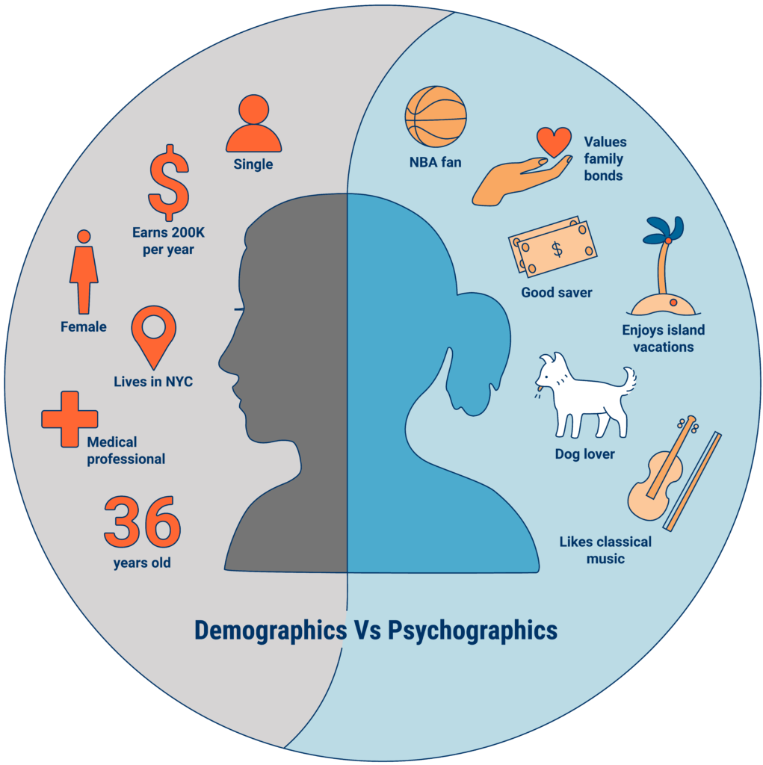
An example of Data Enrichment
They could buy data about employees to have a more complete picture.
An organization may collect some information about employees during interactions.
https://www.cbinsights.com/research/what-is-psychographics/
Kwartler

Slide 32


Modeling with Feature Enrichment is Widespread
Used social media information of individual and friends to model voting tendencies
Uses 3rd party data to predict if a household member has diabetes for marketing.
Most consumers are not aware the type and amount of data that is available about them.
Kwartler

Slide 33
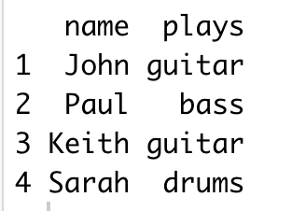
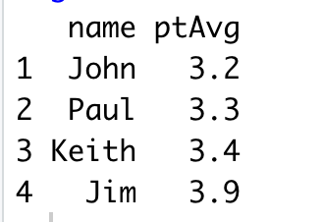
Feature Enrichment Requires a Join
X
Y
Instruments
Grades
Students playing instruments
Student Grades from Honors Science Class
It’s kind of like a vlookup…matching records from one table to another.
Kwartler
Notes:
Very common to append the existing data as the left side
Grades could have millions of more records than instruments table. The only rows that are kept are the instrument table X

Slide 34

Open H_extra_join_practice.R
Joining Table Practice!
AI Generated Image

Slide 35
Keep this in mind as you’re tackling the problem
Male/Female
Best Possible Model
Patient Factor Information
Numeric Information
Information from text
DR notes “patient exhibits…”
Height, wgt

Slide 36
Diabetes Basic Level
Scrub
Determine Missing, outliers etc.
Exploration, visualization
Obtain
Read.csv()
Success is having a data frame with the variables you think are appropriate from the already scrubbed data, summary stats, and visualizations.
write.csv()

Slide 37
Diabetes Case – Mid Level Steps
ID categorical vars
Encode the categorical vars
Deal with missing
Cbind all the data into a modeling matrix
Obtain the data
ID numeric vars
Deal with missing
Exploration, visualization & Feature engineering?
write.csv()

Slide 38
Diabetes Case – Master Level Steps
ID categorical vars
Encode the categorical vars
Deal with missing
Cbind all the data into a modeling matrix
Obtain the data
ID numeric vars
Deal with missing
Exploration, visualization & Feature engineering?
write.csv()
ID text vars
Create a document term matrix

Slide 39

Get working!

